Slide 1
Deep Learning for Vessel Segmentation
in Cerebral CTA
A Controlled Ablation of Topology-Aware Loss Functions
Samih Tharwat Amer
Whiting School of Engineering | Johns Hopkins University
Midterm Project | April 2026

Slide 2
01
Clinical Motivation
Cerebrovascular diseases
Leading cause of death and disability worldwide. Accurate vessel segmentation from CTA is essential for diagnosis and surgical planning.
Circle of Willis (CoW)
The arterial anastomotic ring at the brain's base. Provides collateral blood flow pathways critical during vascular occlusion.
Communicating arteries (Acom, Pcom)
Thin (<1 mm diameter) but clinically critical for aneurysm assessment and collateral flow. Most prone to segmentation failure.
[Circle of Willis
Anatomy Diagram]
Large arteries: 3-5 mm diameter | Communicating arteries: <1 mm diameter | Clinical impact: inversely proportional to size

Slide 3
02
The Problem: Topological Failures
Dice + Cross-Entropy loss treats all voxels equally — no connectivity incentive
A segmentation can have high Dice (0.87) but broken topology — severed vessels, fragments
Aggregate metrics hide failures on thin communicating arteries
"The model missed a significant number of vessels in clinical 3D visualization, despite the validation DSC looking reasonable on paper."
Global DSC: 0.87 R-Pcom DSC: 0.42 L-ACA DSC: 0.46

Slide 4
03
The TopCoW Challenge
Challenge Overview
Evaluation Protocol
MICCAI 2024 Challenge
Topology-aware anatomical segmentation of the Circle of Willis for CTA and MRA
125 CTA + 125 MRA volumes
Expert voxel-level annotations for 13 vessel classes
Key finding from challenge:
Even top teams achieve good aggregate Dice while producing topologically incorrect segmentations
Dice Score (DSC)
Voxel overlap between prediction and ground truth
Centerline Dice (clDice)
Skeleton-level overlap — topology agreement
HD95 (mm)
95th percentile Hausdorff distance — surface accuracy
Betti-0 Error
Connected component mismatch — topological correctness

Slide 5
04
Related Work & State of the Art
Segmentation Backbone
Topology-Preserving Losses
Other Approaches
nnU-Net
clDice
Persistent Homology
Isensee et al., Nat. Methods 2021
Shit et al., CVPR 2021
Berger, Stucki (MICCAI/ICML)
Self-configuring 3D U-Net. Established Dice+CE as standard. Dominant framework.
Differentiable soft-skeletonization. First topology-preserving loss for tubular structures.
Topological loss via persistence barcodes.
nnU-Net Revisited
Skeleton Recall
NexToU
Isensee et al., MICCAI 2024
Kirchhoff et al., ECCV 2024
Shi et al., 2023
Call for rigorous validation in 3D medical image segmentation.
CPU-precomputed skeletons. Efficient centerline recall.
Topology-aware U-Net architecture.
CBD-Loss
Cascaded U-Net
Shi et al., MICCAI 2024
Rougé et al., PLOS ONE 2024
Joint centerline + boundary optimization.
Topology-aware multi-task approach.
Gap: Existing evaluations confound loss function effects with architectural changes or aggregate-only challenge metrics

Slide 6
05
Hypothesis & Approach
HYPOTHESIS
Topology-aware loss functions will disproportionately improve
segmentation of thin communicating arteries (Acom, Pcom)
Config 1
Config 2
Config 3
Dice + CE
Dice + CE + clDice
Dice + CE + Skeleton Recall
Baseline — overlap only
nnU-Net default
Centerline matching
Shit et al., CVPR 2021
Centerline recall
Kirchhoff et al., ECCV 2024
Controlled ablation: same architecture, same data, same hardware — only the loss function changes

Slide 7
06
Datasets
TopCoW 2024
TopBrain 2025
MICCAI Challenge Dataset
Extended Annotations — Same Scans
125
CTA volumes with expert annotations
25
CTA volumes (same scans as TopCoW subset)
13
Circle of Willis vessel classes
40
vessel classes — 3× more coverage
100 / 25
train / validation split (80/20)
New:
distal branches, posterior fossa, small arteries, venous sinuses
Classes:
BA, ICA, MCA, PCA, ACA, Acom, Pcom, 3rd-A2
Binarized:
GT covers far more vasculature
Used for:
From-scratch training
Used for:
Fine-tuning & transfer evaluation

Slide 8
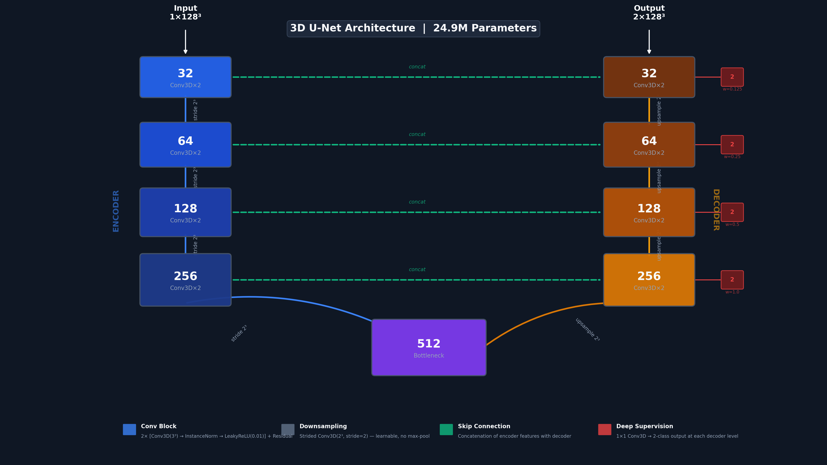
07
Architecture: 3D U-Net
Encoder
5 stages: 32 → 64 → 128 → 256 → 512 ch
Blocks
2× Conv3D(3³) + InstanceNorm + LeakyReLU(α=0.01) + residual
Downsampling
Strided 2³ convolutions (learnable, no max-pool)
Upsampling
Transposed convolutions + skip connections (concat)
Deep Supervision
1×1 heads at each decoder level, weights: 1.0, 0.5, 0.25, 0.125
Parameters
24.9M (Kaiming normal init)
Design
nnU-Net philosophy (Isensee et al., 2021)
Why 3D U-Net? Strongest controlled baseline — any performance difference attributable to the loss function, not the architecture

Slide 9
08
Loss Functions: Dice + Cross-Entropy (Baseline)
Soft Dice Loss
Cross-Entropy Loss
LDice = 1 − 2 ∑ pᵢ · gᵢ + ε / (∑ pᵢ + ∑ gᵢ + ε)
LCE = − ∑ gᵢ · log(pᵢ)
pᵢ = predicted probability at voxel i
gᵢ = ground truth label at voxel i
ε = 10⁻⁵ (numerical stability)
Standard per-voxel classification loss. Provides sharp gradients for individual voxel decisions.
Lbase = LCE + LDice
Measures region-level overlap. Per-class computation (excluding background), then averaged.
Limitation: Every voxel receives equal weight. A centerline voxel of a 1mm Pcom gets the same gradient as a surface voxel of the 5mm ICA.

Slide 10
09
Loss Functions: Soft Centerline Dice (clDice)
Differentiable Soft-Skeletonization
Topology Metrics
skel(x) = ReLU(x − open(x))
+ Σk=1..K ReLU(erodek(x) − open(erodek(x)))
erode(x) = −MaxPool3D(−x, k=3) | dilate(x) = MaxPool3D(x, k=3)
open(x) = dilate(erode(x)) | K = 10 iterations
Tprec = |skel(ŷ) · y| / |skel(ŷ)|
Tsens = |ŷ · skel(y)| / |skel(y)|
clDice = 2·Tprec·Tsens / (Tprec+Tsens)
Combined: LclDice = (1 − α) · Lbase + α · (1 − clDice) α = 0.5
Intuition: Computes skeletons (centerlines) of both prediction and ground truth, then measures how well they overlap. Directly penalizes topological disconnection — if the prediction's centerline doesn't match the ground truth's centerline, the loss increases. Measures both precision (predicted skeleton inside GT) and sensitivity (GT skeleton covered by prediction).

Slide 11
10
Loss Functions: Skeleton Recall
Skeleton Recall Loss
Key Differences from clDice
Lskel = (1−α) · Lbase + α · (1 − ∑ ŷ · skel(y) / ∑ skel(y))
CPU precomputation
No GPU-intensive iterative operations
Recall only
Does not measure prediction skeleton precision
Binary skeleton
skel(y) = precomputed binary skeleton (CPU, scikit-image)
ŷ = predicted vessel probability map
α = 0.5
Exact morphological thinning, not soft approximation
Computationally efficient
~13% overhead vs baseline
Intuition: "Did you find the core of every vessel?" Precomputes a 1-voxel-wide centerline of the ground truth, then asks how much of this skeleton the prediction covers. Focuses all gradient signal on centerline voxels — even at the cost of over-segmentation. The base Dice+CE handles false positives; Skeleton Recall ensures the thinnest structures aren't missed.
Summary of Loss Functions
Loss | Topology Signal | Computation | Trade-off
Dice+CE | None | Fastest | No topology awareness
+ clDice | Precision + Recall | GPU-intensive (K=10 iters) | Best aggregate metrics
+ Skeleton Recall | Recall only | CPU precompute (+13%) | Best thin-vessel detection

Slide 12
11
Training Setup
Hardware
8× NVIDIA A100-SXM4-40GB (AWS p4d.24xlarge)
Training
DDP across all 8 GPUs — identical for all 3 models
Epochs
300 (from-scratch) | 150 (TopBrain fine-tuning)
Optimizer
AdamW (LR = 10⁻³, weight decay = 10⁻⁵)
LR Schedule
Cosine annealing + 10-epoch linear warmup (10⁻⁷ → 10⁻³ → 10⁻⁷)
Patches
128³ voxel crops, 4 per volume, 33% foreground-centered
Batch Size
4 per GPU (32 effective) | Mixed precision (AMP)
Validation
Every 25 epochs | Early stopping patience = 5 cycles
Fine-tuning
Best checkpoint, fresh optimizer, LR = 10⁻⁴, 5-epoch warmup
All training configuration identical across runs — controlled single-variable comparison

Slide 13
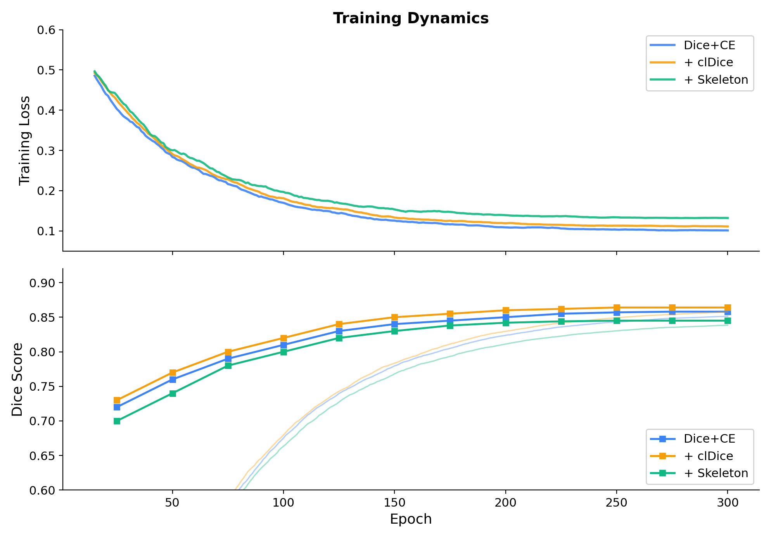
12
Training Dynamics
All three models converge to similar regions:
Training loss: ~0.10–0.13
Validation Dice: ~0.84–0.86
clDice and Dice+CE are nearly identical
Skeleton Recall runs at slightly higher loss — expected from additional centerline penalty
Stable convergence across all configurations. No NaN batches.

Slide 14
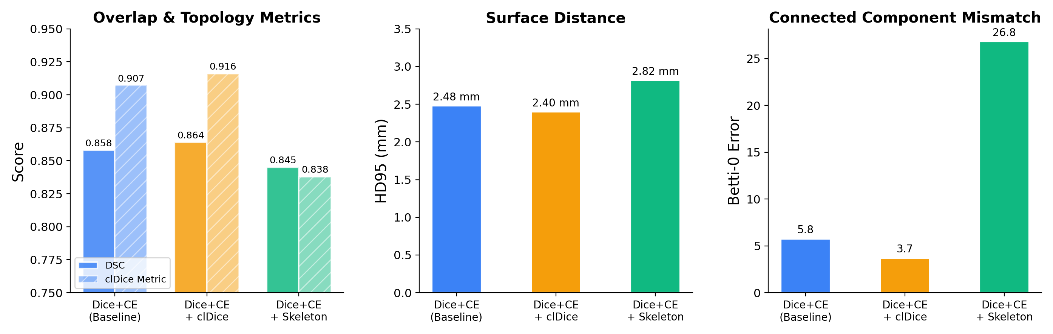
13
Global Results — From Scratch
clDice wins aggregate
DSC 0.864 | clDice 0.916
Lowest Betti-0 error: 3.72
Baseline close behind
DSC 0.858 | clDice 0.907
Betti-0 error: 5.76
Skeleton Recall
Lower aggregate (DSC 0.845)
High B0 error: 26.84 (over-segments)

Slide 15
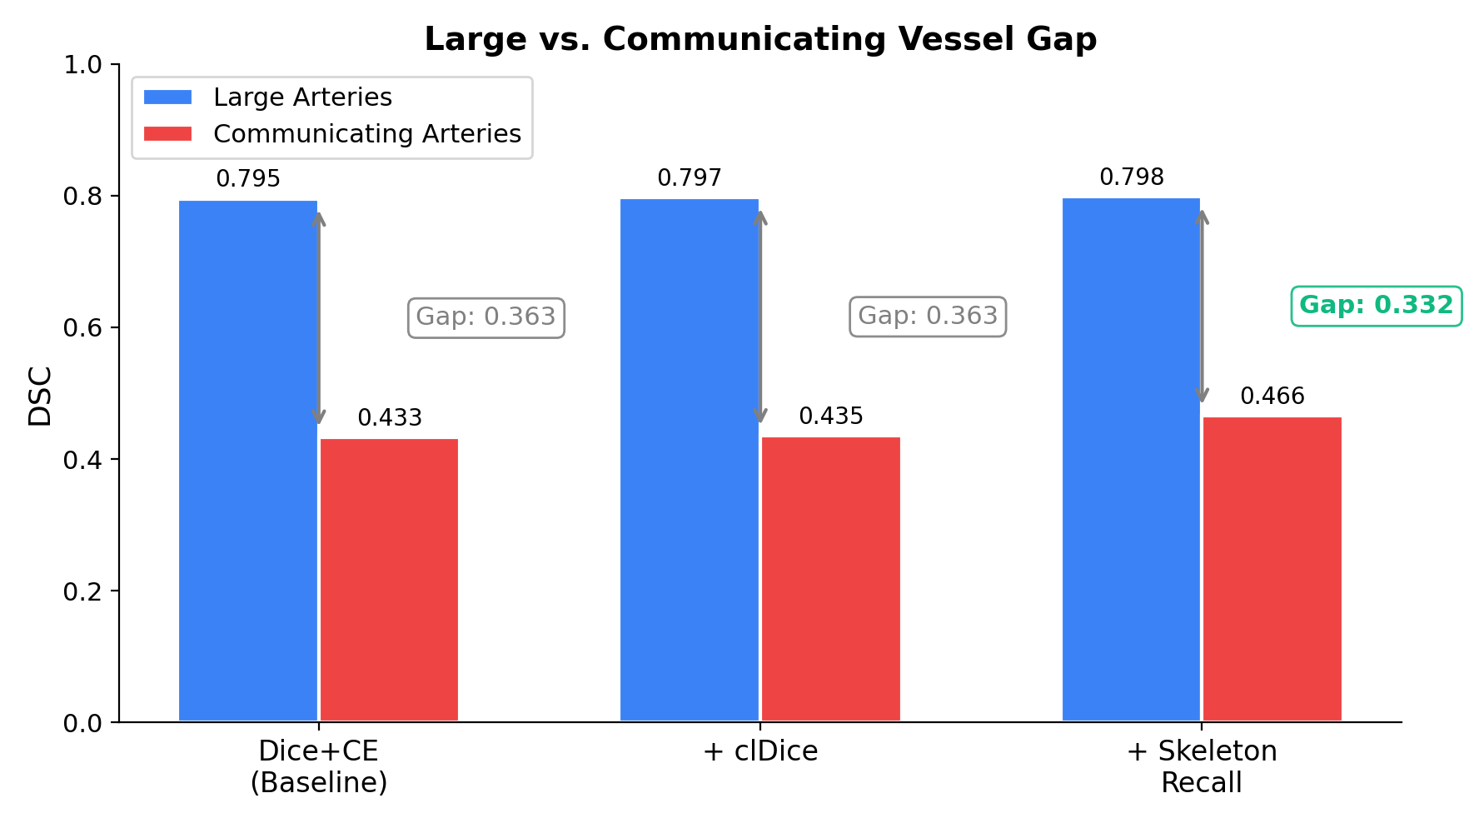
14
Stratified Results — The Vessel Gap
Skeleton Recall → Pcom Improvement
R-Pcom: 0.511 vs 0.459 baseline (+5 pts)
L-Pcom: 0.479 vs 0.410 baseline (+7 pts)
Vessel Gap Analysis
Model | Large | Comm. | Δ
Dice+CE | 0.795 | 0.433 | 0.363
+ clDice | 0.797 | 0.435 | 0.363
+ Skeleton | 0.798 | 0.466 | 0.332
Hypothesis partially supported: modest but targeted improvement on communicating arteries

Slide 16
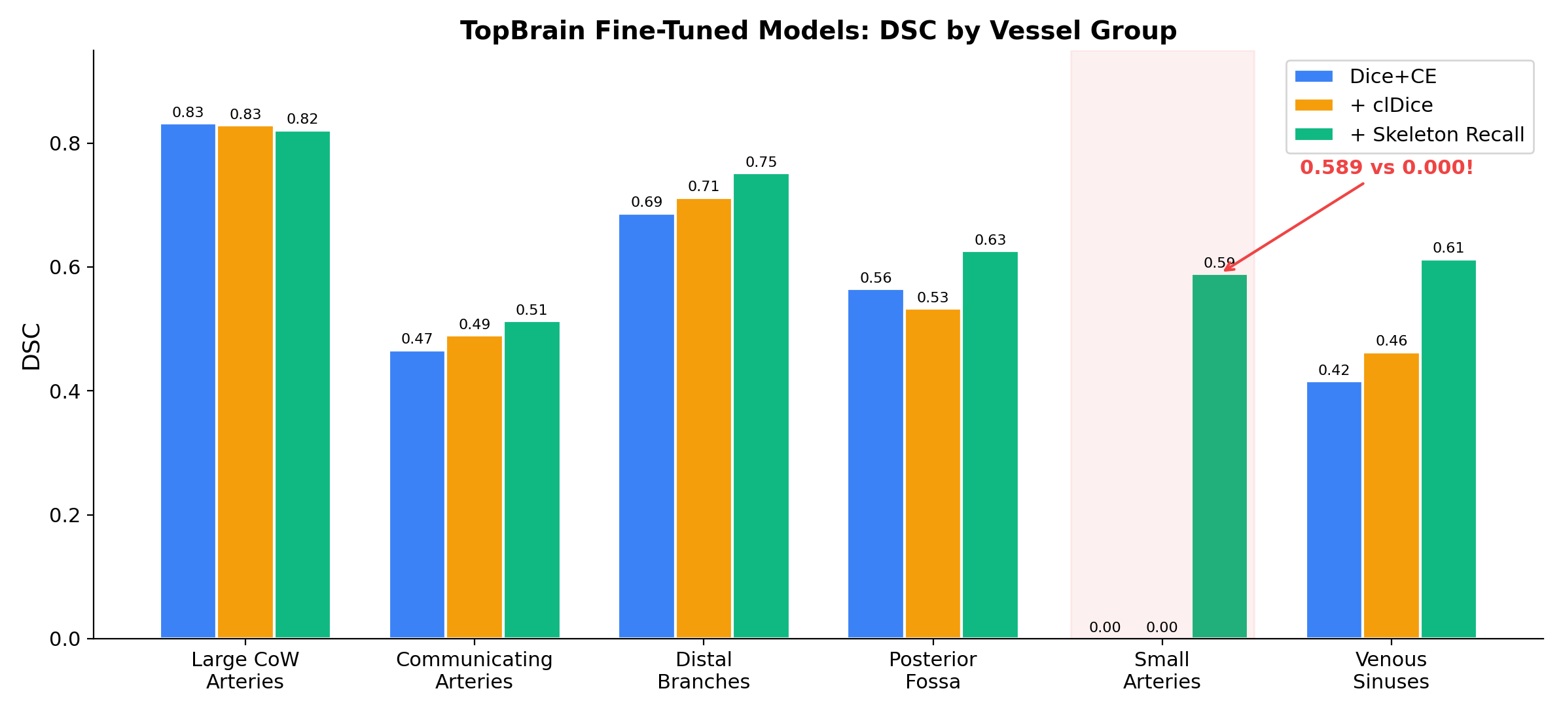
15
TopBrain Fine-Tuning — The Big Result
SMALL ARTERIES
(Ophthalmic, Ant. Choroidal)
0.589
Skeleton Recall
0.000 Dice+CE
0.000 clDice
Posterior fossa:
0.626 vs 0.565 (Dice+CE)
Venous sinuses:
0.613 vs 0.416 (Dice+CE)
Distal branches:
0.752 vs 0.687 (Dice+CE)
Large CoW:
all ~0.82 (comparable)
Skeleton Recall finds vessels the others cannot — a qualitative, not merely quantitative, difference

Slide 17
16
Qualitative Comparison — 3D Renderings
[SurgicalAR Screenshot]
[SurgicalAR Screenshot]
Dice+CE + TopBrain
Skeleton Recall + TopBrain
Same patient | Same viewing angle | Same fine-tuning protocol | Different loss during pretraining

Slide 18
17
Discussion — What We Learned
clDice
Skeleton Recall
Best Aggregate Model
Best Thin-Vessel Transfer
DSC 0.864 | Betti-0 error 3.72
Pcom: +5–7 pts | Small arteries: 0.589
Improves topological precision
Improves topological recall
Fewer disconnected fragments
Over-segments (B0 error 26.84)
Best for: overall segmentation quality
Best for: finding every vessel
KEY INSIGHT
TopBrain fine-tuning drives comprehensive vessel coverage for all models.
The loss function used during pretraining shapes the quality of that transfer to the thinnest structures. Skeleton Recall's centerline-focused gradient signal creates feature representations that encode thin tubular geometry — a representational advantage that transfers when exposed to richer annotations.

Slide 19
18
Limitations & Future Work
Limitations
Future Work
Large-small vessel gap persists
Wider HU window [0, 1500]
>0.33 DSC across all models
Separate bone from vessels — highest-impact fix
Skeleton Recall over-fragments
Class-balanced sampling
Betti-0 error 26.84 needs post-processing
Focus on under-represented thin vessels
HU window [0, 600]
Connected component filtering
Clips bone to same range as vessels → false positives
Remove small disconnected false positives
Retrain on corrected labels
50 model-assisted labeled CTAs on RedBrick AI

Slide 20
19
Conclusion
Controlled ablation on identical hardware
3 loss functions, same 3D U-Net, same 8× A100 configuration
clDice = best aggregate model
DSC 0.864, lowest Betti-0 error 3.72, best topological precision
Skeleton Recall = best thin-vessel transfer
+5–7 pts on Pcom, 0.589 on small arteries vs zero for alternatives
Topology-aware pretraining creates better representations
Loss function during pretraining shapes how well coverage transfers to thinnest structures
Hypothesis partially supported
Modest CoW improvement; dramatic effect on truly small vessels after transfer
The large-vs-small vessel gap remains the central challenge — the arteries that matter most clinically are the hardest to find.

Slide 21
Thank You
Questions?
Samih Tharwat Amer
Whiting School of Engineering | Johns Hopkins University

